Slide 1
CYBER!
Andrea Matwyshyn
@amatwyshyn

Slide 2
Who am I? (Seriously? Comic Sans?)

Slide 3
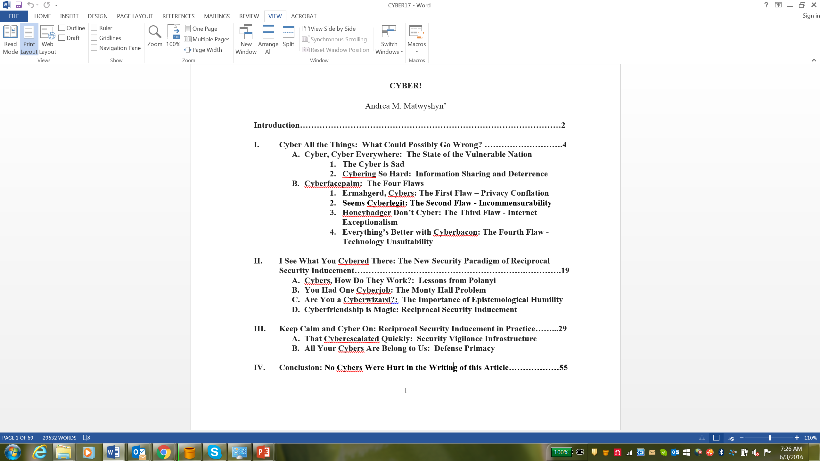

Slide 4
The Cyber is Sad

Slide 5
Cybering So Hard: Information Sharing and Deterrence

Slide 6
Cyberfacepalm: The Four Flaws Ermahgerd, Cybers: The First Flaw – Privacy Conflation

Slide 7
Seems Cyberlegit: The Second Flaw - Incommensurability

Slide 8
Honeybadger Don’t Cyber: The Third Flaw - Internet Exceptionalism

Slide 9
Everything’s Better with Cyberbacon: The Fourth Flaw - Technology Unsuitability

Slide 10
I See What You Cybered There: The New Security Paradigm of Reciprocal Security Inducement

Slide 11
Cybers, How Do They Work?: Lessons from Polanyi

Slide 12
You Had One Cyberjob: The Monty Hall Problem

Slide 13
Are You a Cyberwizard?: The Importance of Epistemological Humility

Slide 14
Cyberfriendship is Magic: Reciprocal Security Inducement

Slide 15
Keep Calm and Cyber On: Reciprocal Security Inducement in Practice

Slide 16
That Cyberescalated Quickly: Security Vigilance Infrastructure

Slide 17
All Your Cyber Are Belong to Us: Defense Primacy

Slide 18
Conclusion: No Cybers Were Hurt in the Writing of this Article

